Slide 1
EE 2361: Introduction to Microcontrollers
Peng Li
lipeng@umn.edu
06/22/2015

Slide 2
Topics
ports1.s
Loops
Multiplication
Indirect Addressing

Slide 3
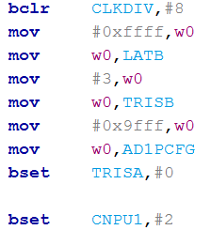
ports1.s
Exercise: how to enable pull-up register on RB1?

Slide 4
Loops
BRA instruction
 | Clock 1 | Clock 2 | Clock 3 | Clock 4
Loop0: INC W0 | Fetch | Execution
DEC W0 |  | Fetch | Execution
BRA Z, Loop0 |  |  | Fetch | Execution: if taken, 2 cycles (pipeline flush); if not taken, 1 cycle (pipeline continues) ;

Slide 5
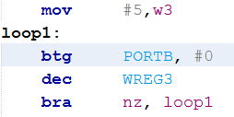
Loops (asm2_loops.s)
Style 1
How many clock cycles does loop1 take?

Slide 6
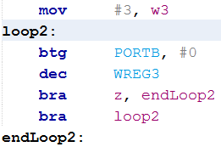
Loops (asm2_loops.s)
Style 2
How many clock cycles does loop2 take?

Slide 7
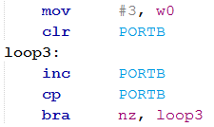
Loops (asm2_loops.s)
Style 3

Slide 8

Loops (asm2_loops.s)
Style 4

Slide 9

Loops (asm2_loops.s)
Infinite Loop

Slide 10
Exercise 1
Show 10, 9, 8, …, 1 on PORTB.

Slide 11
Exercise 2
Show 0, 5, 10, 15, …, 45 on PORTB.

Slide 12
Exercise 3
Compute W10 = 1 + 2 + 3 + … + 10.

Slide 13
MUL.UU
Page 319 of programmer manual

Slide 14
Example
Page 319 of programmer manual

Slide 15
More MUL instructions
MUL
MUL.SS
MUL.SU
MUL.US
MULW.SS
MULW.SU
MULW.US
MULW.UU
Refer to Table 3-3 on Page 41-42 of programmer manual.
Detailed description can be found on Page 303-392 of programmer manual.

Slide 16
Exercise 1
Show 0, 5, 10, 15, …, 45 on PORTB, using multiply instruction.

Slide 17
Exercise 2
Write a program to compute 0x12345678 * 0x89ABCDEF
0x5678 * 0xCDEF
0x5678 * 0x89AB + 0x1234 * 0xCDEF
0x1234 * 0x89AB

Slide 18
Data Address Modes
Page 52 of programmer manual

Slide 19
File Register Addressing
Page 53 of programmer manual.

Slide 20
File Register Addressing and WREG
Page 53 of programmer manual.

Slide 21
Register Direct Addressing

Slide 22
Indirect Addressing Modes
Page 54 of programmer manual

Slide 23
Indirect Addressing
Page 55 of programmer manual

Slide 24
Indirect Addressing
Page 55 of programmer manual

Slide 25
Exercise 1
Array A has 10 elements, copy Array A to Array B. (asm_indirect1.s)

Slide 26

Exercise 2
Compute W12 = $\sum_{i=0}^{9}{arrayA[i]}$ (asm_indirect2.s)

Slide 27
asm_indirect3.s
Difference between ADD and ADD.B

Slide 28
Reading Assignment
Kia’s video: https://www.youtube.com/watch?v=WPXUX3Da2K0 https://www.youtube.com/watch?v=lTZaSsRqaQs https://www.youtube.com/watch?v=mpY1BP4dfnE
Multiply instructions: page 303-392 of programmer manual.
Data addressing modes: page 52 – 59 of programmer manual.

